Slide 1
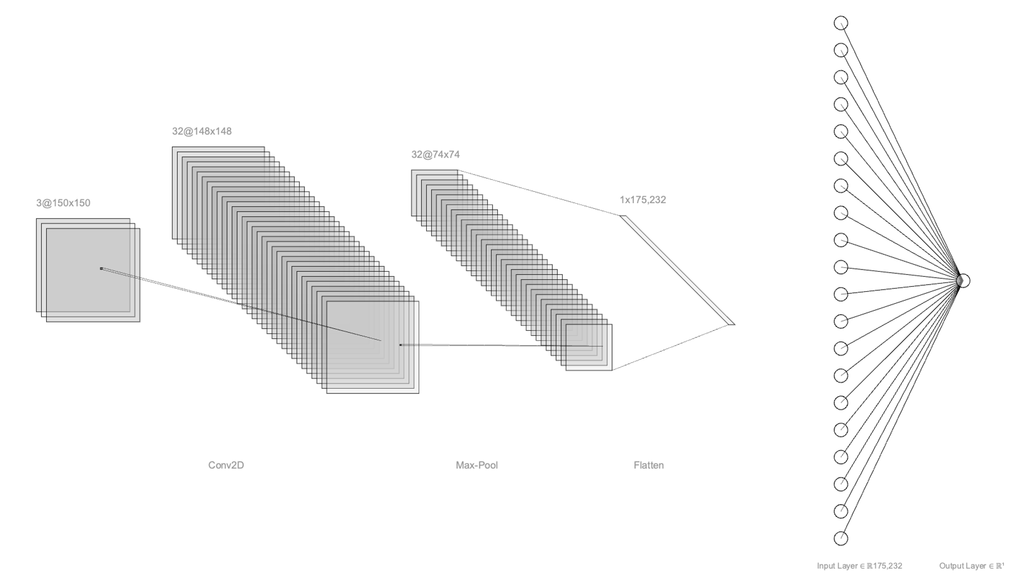
ICS474 – Big Data Analytics
Jawad almuttAwa
201953470

Slide 2


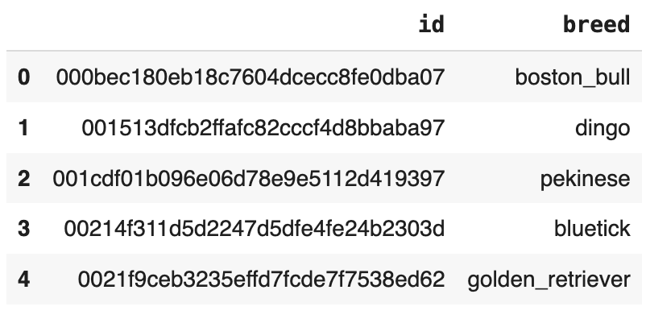
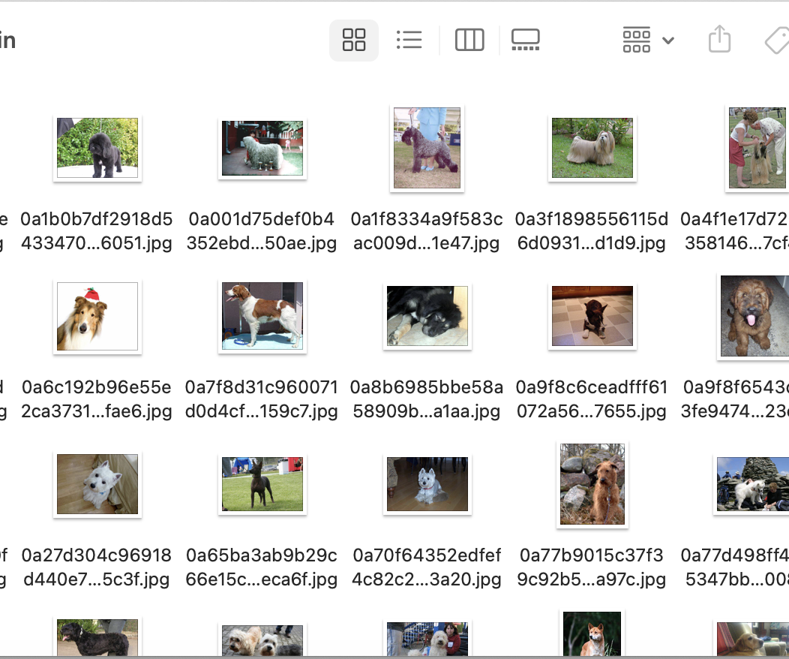
Dataset
CSV file contains the image id and the breed.
Test images are not labeled.

Slide 3
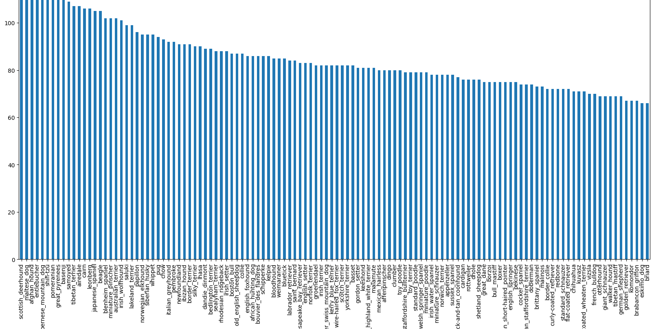
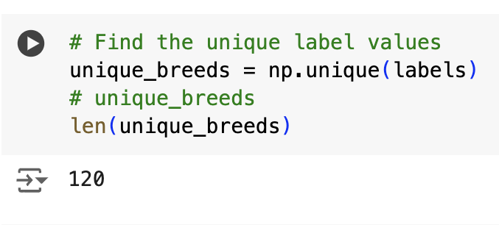
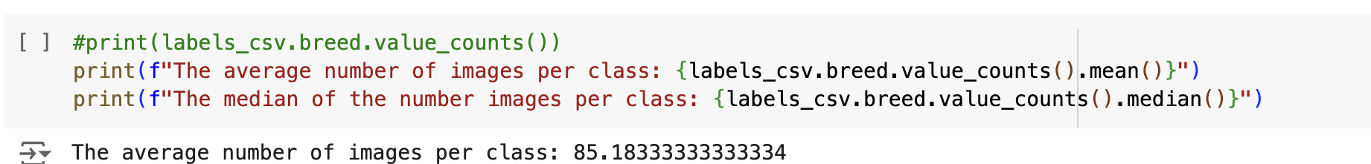

Slide 4
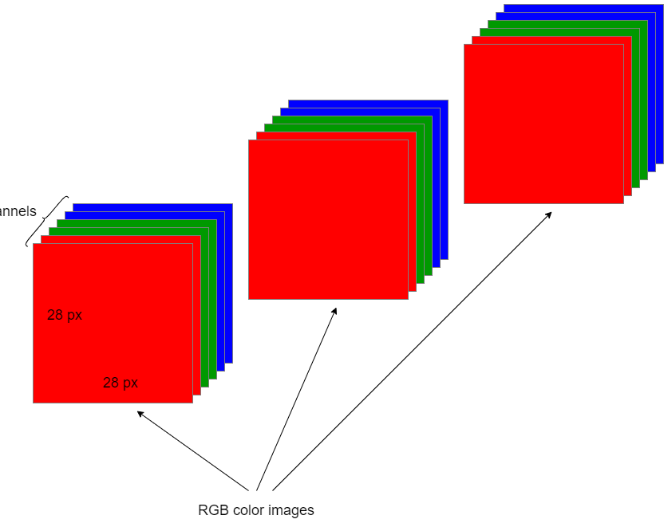
Preprocessing images
Turn the image variable (a jpg) into Tensors.
Normalize the image by converting color channel values from [0 - 255] to [0 - 1].
Resize the image to be a shape of (224, 224).
Create batches of 32 images per batch.

Slide 5
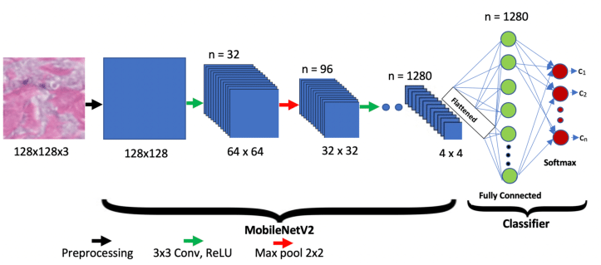
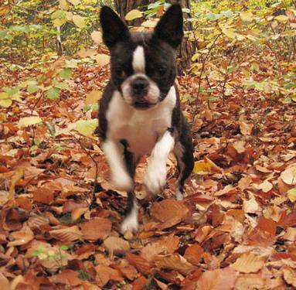
Building the model

Slide 6
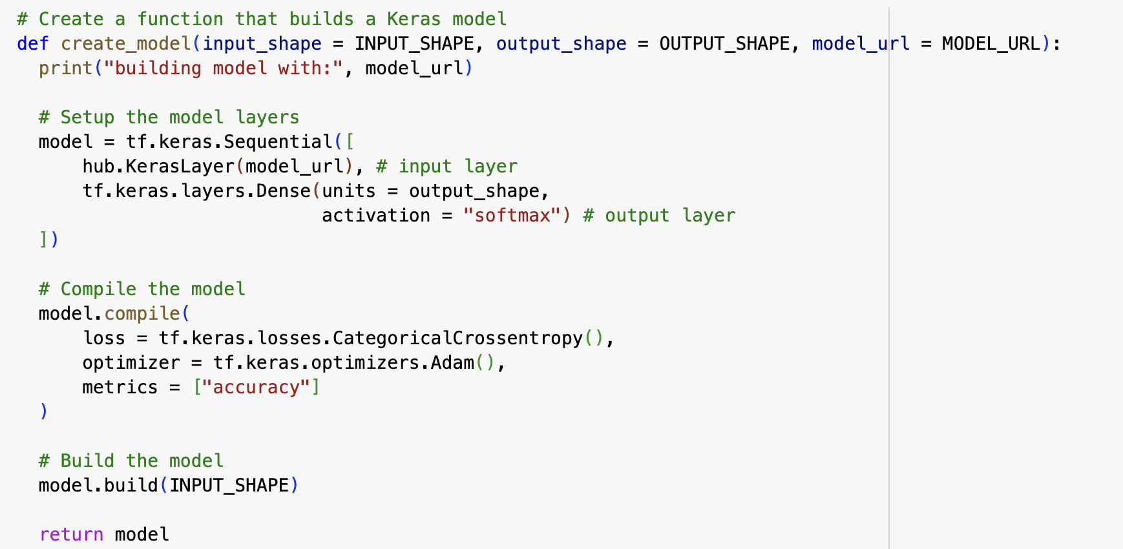

Slide 7
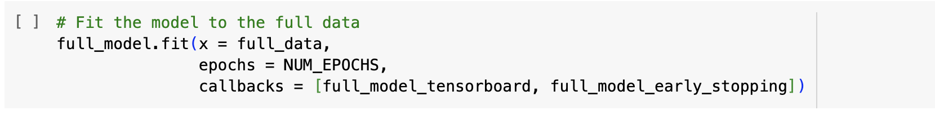

Slide 8
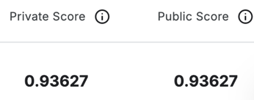
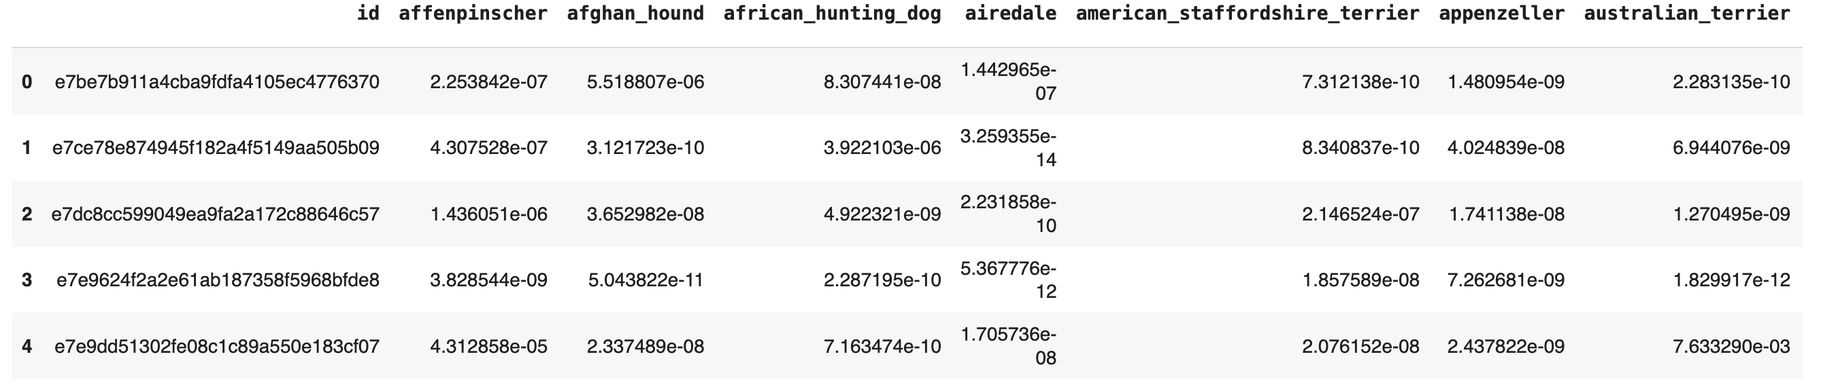
Evaluating the model

